Slide 1

H1-B PREDICTION USING ML
BY:-
ARYAMAN SINGH
UJJWAL SAHARIA
ANSHUL ANAND
SURAJ KUMAR

Slide 2
INTRODUCTION
The H-1B is an employment-based visa in the United States, which allows U.S. employers to temporarily employ foreign workers in specialty occupations.
To apply for H-1B visa, an U.S employer must offer a job and petition for H-1B visa with the U.S. immigration department.
This is the most common and legal visa status and for international students who complete their college / higher education (Master, PhD) and work in a full-time position.
Briefly, In this project, we apply machine learning algorithms including Decision Tree, Random forest and Logistic Regression to analyze the conditions (or attributes) of the foreign workers, such as SOC_NAME, WAGE, etc

Slide 3
OBJECT
We hope to predict the outcome of H-1B visa applications, which are filed by a large number of high-skilled foreign nationals each year. We framed the challenge as a classification problem and used Logistics regression,rAN to predict the application's case status. The attributes of the applicant are the input to our algorithm, which will be detailed in more detail in the following sections.

Slide 4
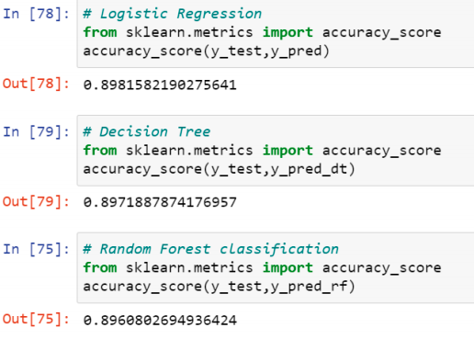
ACCURACY OF DIFFERENT MODEL

Slide 5
Result
In this paper we have used logistic regression for the prediction and compared it with other algorithms like random forest and decision tree but between all logistic regression gives best prediction percentage of 89.81.

Slide 6
Conclusion
Several machine learning models, such as Random Forest and Naïve Bayes, can be used to predict the outcome of H-1B visa applications based on the applicant's qualities.
We tried to use the logistic regression model for the project as it was more convenient for the group to perform. Finally, it's possible to include this into a web application and find out the predictability of the visa.

Slide 7


